Slide 1
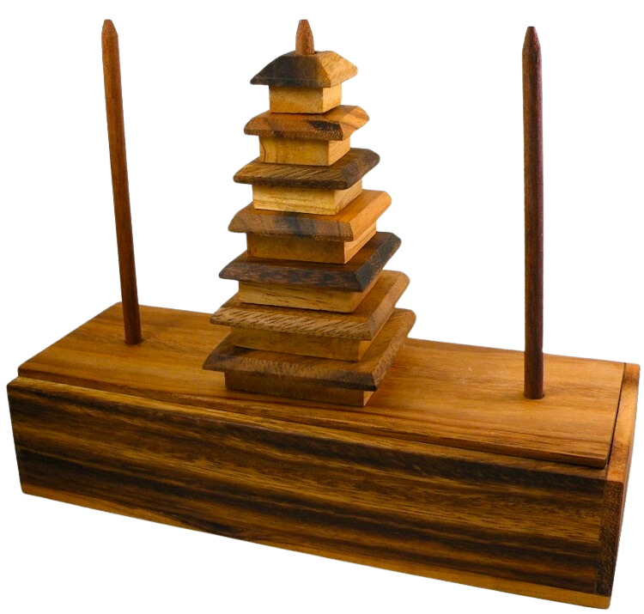
TOWER OF HANOI
Students
Mehmet Fatih Çapal - 042101115
Mustafa Eren Soyhan - 042101008
Rahiq Al-huslan - 042101140
Mevlüt korkmaz -042101057

Slide 2
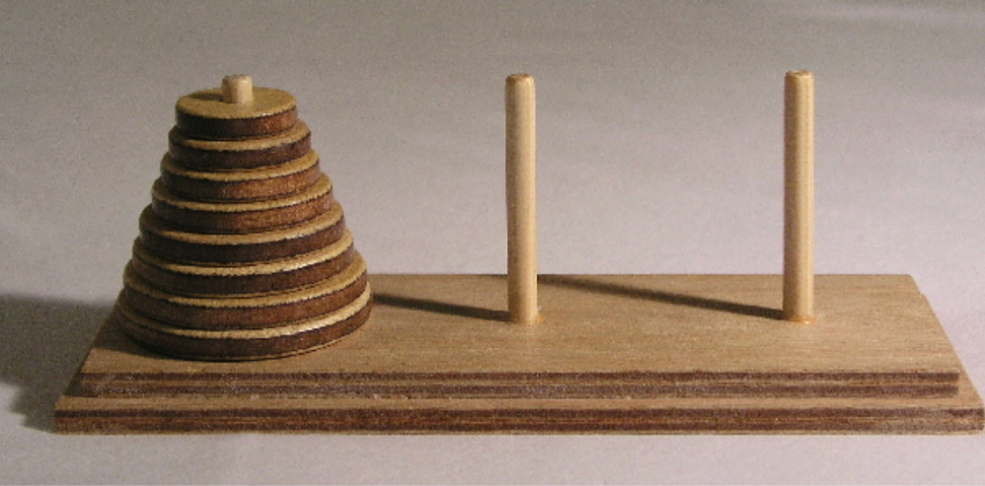
INTRODUCTION
# TOWER OF HANOI PROBLEM: AN ALGORITHMIC ANALYSIS
- The Tower of Hanoi is a classic problem in computer science and mathematics.
- Proposed by the French mathematician Edouard Lucas in 1883.
- This project focuses on the algorithmic analysis of solving the Tower of Hanoi problem.

Slide 3

PROBLEM
# PROBLEM STATEMENT
# OBJECTIVE
- Definition of the Tower of Hanoi problem:
- Three pegs and a number of disks of different sizes.
- The puzzle starts with the disks in a neat stack in ascending order of size on one peg, the smallest at the top.
- The primary objective:
- Move the entire stack to another peg, obeying the following simple rules:
1. Only one disk can be moved at a time.
2. Each move consists of taking the upper disk from one of the stacks and placing it on top of another stack or an empty peg.
3. No disk may be placed on top of a smaller disk.

Slide 4

- Algorithmic Foundation:
- Fundamental for understanding recursive algorithms.
- Optimization Benchmark:
- Used to test efficiency in optimization algorithms.
- Mathematical Connection:
- Demonstrates the link between math and computer science.
- Practical Applications:
- Influences real-world disk storage optimizations.
- Recursive Thinking:
- Serves as a foundation for understanding recursion.
- Problem-Solving Paradigm:
- Encourages divide-and-conquer approaches.
# IMPORTANCE OF THE TOWER OF HANOI

Slide 5
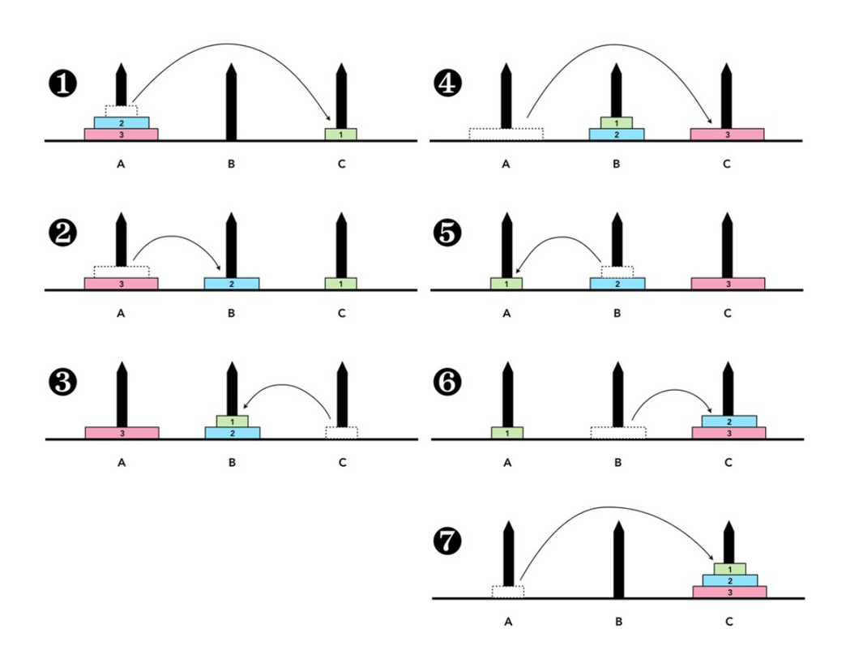
SOLUTION
SOLUTION OF A TOWER OF HANOI WITH THREE DISKS(3)
The Tower of Hanoi provides a step-by-step methodology for problem-solving, serving as an excellent illustration of effective task management. This approach mirrors the classic strategy of breaking down a larger problem into smaller, more manageable components—a fundamental principle akin to the "divide and conquer" strategy.
CONCLUSION

Slide 6
GUI AND GUI’S FUNCTIONALITIES
1. Graphical User Interface (GUI)
The GUI serves as a visual representation of the code's functionalities.
Utilized the Tkinter library for GUI implementation with the Tk toolkit.
Incorporated the 'time' library for time-related tasks and 'threading' for handling long-running tasks.
2 . User Interaction
Option Selection:
Two clickable buttons at the top allow users to choose their preferred approach to solve the problem.
Disk Selection:
Users can specify the number of disks for the initial tower beneath the option buttons.
Execution:
The green “Run Algorithm” button initiates the program after the user selects the approach and disk count.
3. Visual Representation
A white rectangle below the green button displays the step-by-step relocation of disks between the three towers.

Slide 7
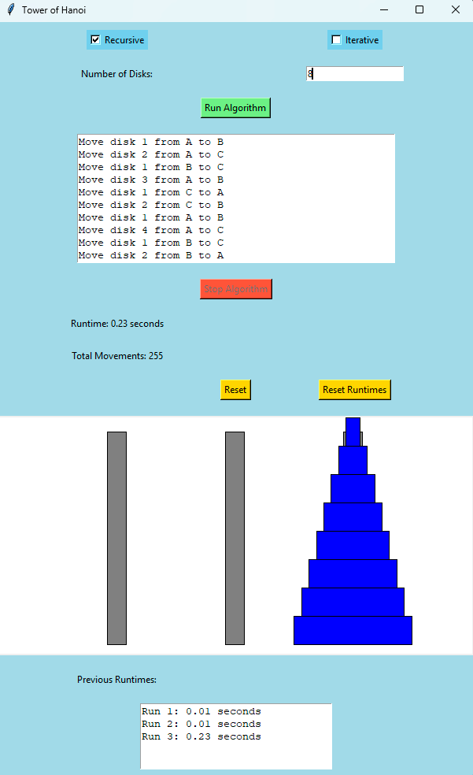
4. Algorithm Information
Runtime and Movements:
“Runtime” and “Total Movements” sections showcase the algorithm's runtime and total disk movements.
Termination:
Program termination occurs either after (2^n)-1 moves or manually by the user.
Control Buttons:
A red “Stop Algorithm” button halts the process, while “Reset” reverses the GUI to its initial state.
“Reset Runtimes” clears previously recorded runtimes in the designated area.
5. Animation Display
The largest white rectangle area provides a visual animation of the algorithm in action.

Slide 8

PERFORMANCE COMPARISON
RECURSIVE APPROACH
ITERATIVE APPROACH
PERFORMANCE COMPARISON:
Recursive Approach’s time complexity is O(2^n)
Each recursive call involves two additional recursive calls, leading to an exponential growth in the number of function calls.
Iterative Approach’s time complexity is O(2^n).
The iterative approach uses a loop to perform the required moves, and the total number of moves is proportional to the number of disks (n).

Slide 9
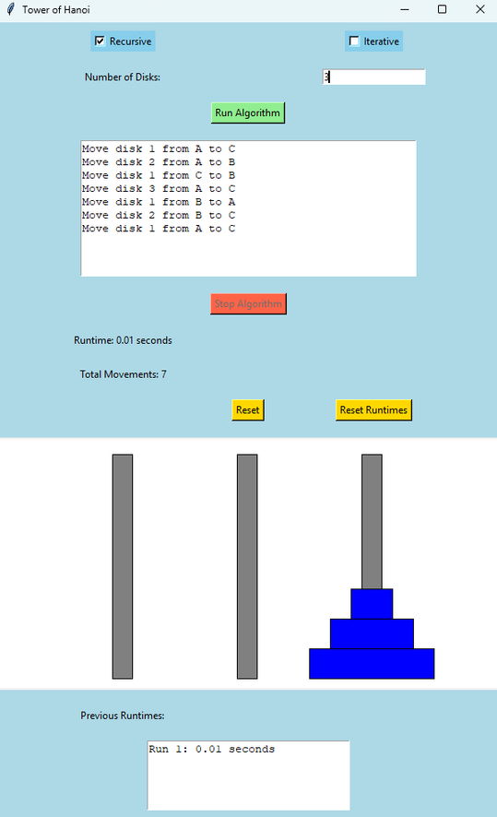
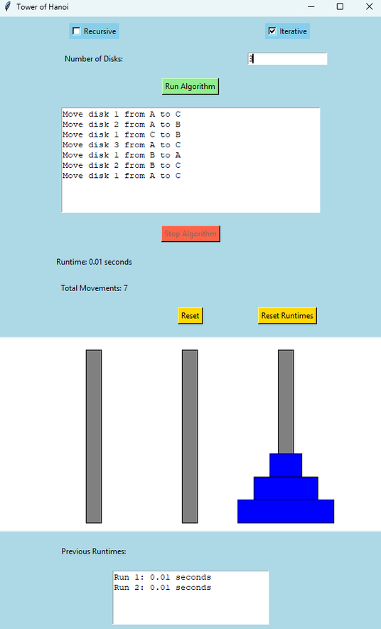
PERFORMANCE OF THE ALGORITHM
Recursive and Iterative Runtimes When There are 3 Disks
RECURSIVE APPROACH
ITERATIVE APPROACH

Slide 10
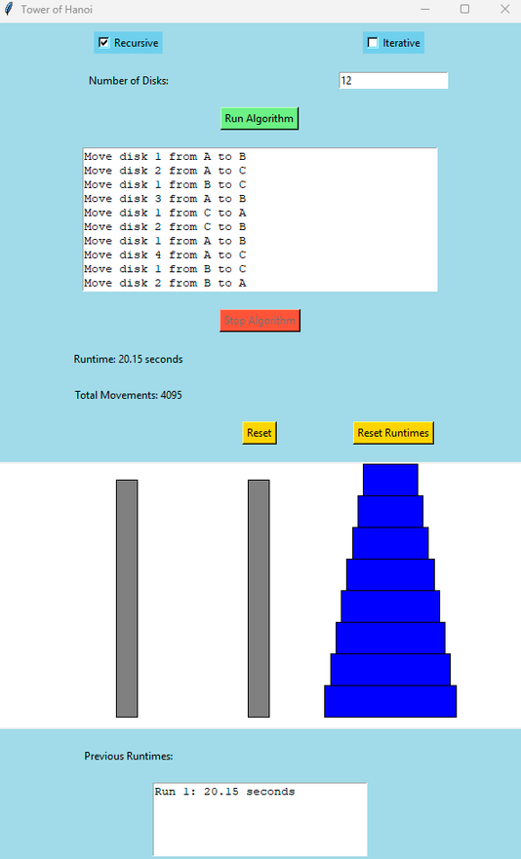
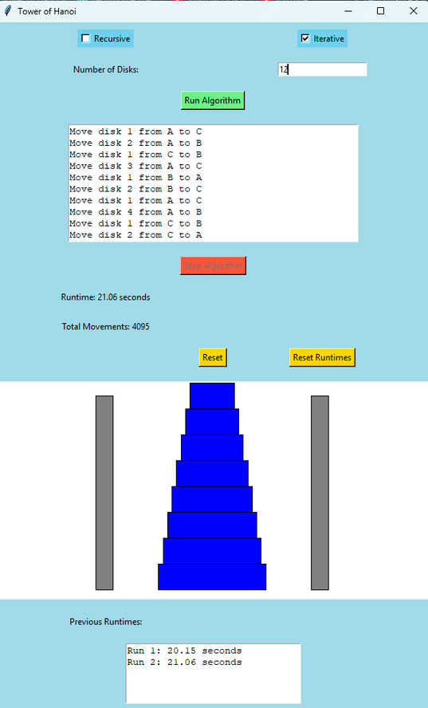
PERFORMANCE OF THE ALGORITHM
Recursive and Iterative Runtimes When There are 12 Disks
RECURSIVE APPROACH
ITERATIVE APPROACH

Slide 11
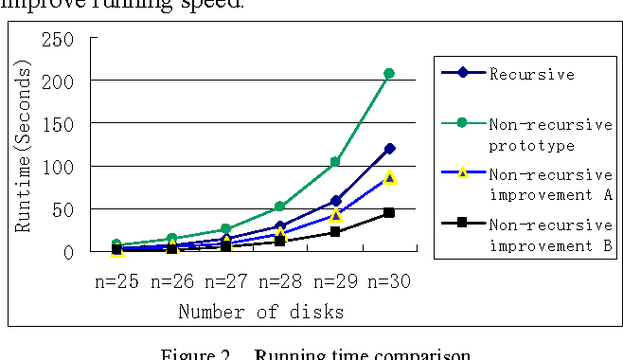
CONCLUSION OF THE PERFORMANCE COMPARISON
1. Performance Analysis
Small Values of n:
No significant differences observed between recursive and iterative approaches.
Large Values of n:
Iterative approach tends to be faster due to lower overhead.
Unexpected Findings:
In our experiments, the recursive approach often demonstrated slightly faster performance with large values of n.

Slide 12
THANK YOU!

